Slide 1
Duplicate these slides for your class
Review teacher notes.
Edit homework/announcements slide accordingly.
Update Student Daily Session Document.
Starter Code
Solution Code
Example Project
Print for students: Project Planning
Print for volunteers: Project Specifications
Feedback Form
Notes:
Teacher Notes:
This slide needs to be deleted once you’ve completed your preparation. Copy these slides to your team’s drive and do not link the originals to the Daily Session Document. Make sure to PRINT the project planning document.

Slide 2
Make sure the Project specs are printed
Make sure to print the project planning document
If you think students will struggle with forking, add the step by step slides from 1.1
If you think students will struggle with pushing changes to github, add the step by step slides from 1.1
Notes:
Teacher Notes:
This slide needs to be deleted once you’ve completed your preparation. Copy these slides to your team’s drive and do not link the originals to the Daily Session Document. Make sure to PRINT the project planning document.

Slide 3
In this unit, coders will create a jeopardy game using react. To create this project, coders will use react to take render content, and react to user clicks.
Notes:
Teacher Notes:
This slide needs to be deleted once you’ve completed your preparation. Copy these slides to your team’s drive and do not link the originals to the Daily Session Document. Make sure to PRINT the project planning document.

Slide 4
更新状态（state）来有条件地渲染组件或为组件添加样式
Vocabulary: state（状态）
Notes:
Teacher Notes:
Coders should read aloud the objective. Students should read through each vocabulary word.

Slide 5
State of the art!
大多数时候，我们不想只是alert一条消息。
我们希望更改用户在组件中看到的内容。
为此，我们需要更新组件的状态
useState 可以不编写 class 使用 state 等 React 特性。
通过它，可以给组件添加内部state
const [state, setState] = useState(initialState);
返回一个state，以及更新state 的函数

Slide 6
状态：numPets为状态，初始值为0
import React, {useState} from 'react';
export default function Cat(props) {
let [numPets] = useState(0);
return (
<div onClick={meow}>
<p> Name: {props.name} </p>
<p> {numPets} </p>
</div>
)
}

Slide 7
改变状态的办法：使用setNumPets改变numPets 注意：这里useState()返回的是一个数组，使用解构语法获取返回值
import React, {useState} from 'react';
export default function Cat(props) {
let [numPets, setNumPets] = useState(0);
function pet(){
setNumPets(numPets => numPets +1);
}
return (
<div onClick={pet}>
<p> Name: {props.name} </p>
<p> {numPets} </p>
</div>
)
}

Slide 8
setNumPets 之后，NumPets不会立刻变化
setNumPets(numPets +1);
setState 是异步的
在调用 setState 之后，系统不会立刻执行它，设置状态
所以
setNumPets(numPets + 1);
console.log(numPets) 打印出来的可能还是加一前的值

Slide 9
useEffect 执行附加代码
useEffect
在第一次DOM渲染，和每次DOM更新之后都会执行
setnumPets 后，numPets 的DOM会更新
就会引起 useEffect
就在 useEffect 里根据最新的 numPets 更新 message
参考文献：https://zh-hans.reactjs.org/docs/hooks-effect.html

Slide 10
useRef 访问 DOM 元素或者 class组件
useRef
声明一个 ref 变量
const inputRef = React.useRef();
将它指向一个 DOM 元素
<input ref={inputRef} />
就可以在JS代码中通过它访问这个DOM
inputRef.current 存在这个 DOM
inputRef.current.value 中存着用户在 input 中填写的文本

Slide 11
示例
动态添加同学列表
更新表头

Slide 12
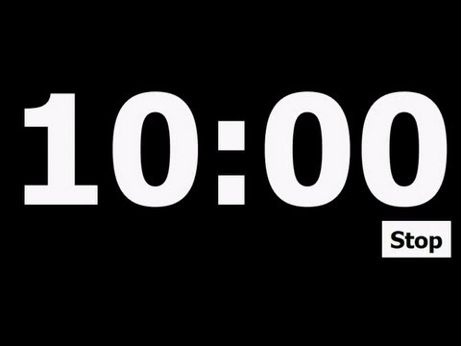
创建一个新的状态变量message，给它一个初值”Meow”
在屏幕上显示这个状态变量
创建一个状态函数setMessage
当用户点击触发pet函数时
使状态numPets加一
如果numPets大于3，更改状态message为”prrr”
如果numPets大于4，更改状态message为”growl”
如果numPets大于5，更改状态message为”hiss”
Notes:
Teacher Notes:
Use this time to walk through the code together. Ask questions along the way. Have students type along with you.
https://popcode.org/?snapshot=67d8801c-064c-442c-a308-5d6f5551f5d2

Slide 13
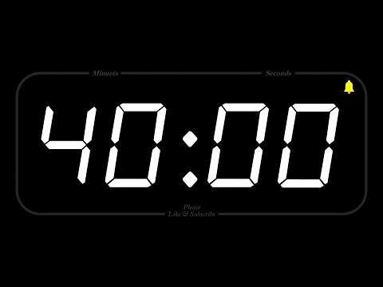
在剩下的40分钟里，你需要完善你的项目：
单击问题时，更新屏幕上每个问题的文本
先显示分值，再显示问题，再显示答案
Notes:
^{Teacher Notes:}
Leave these up so students can refer back to.

